Slide 1
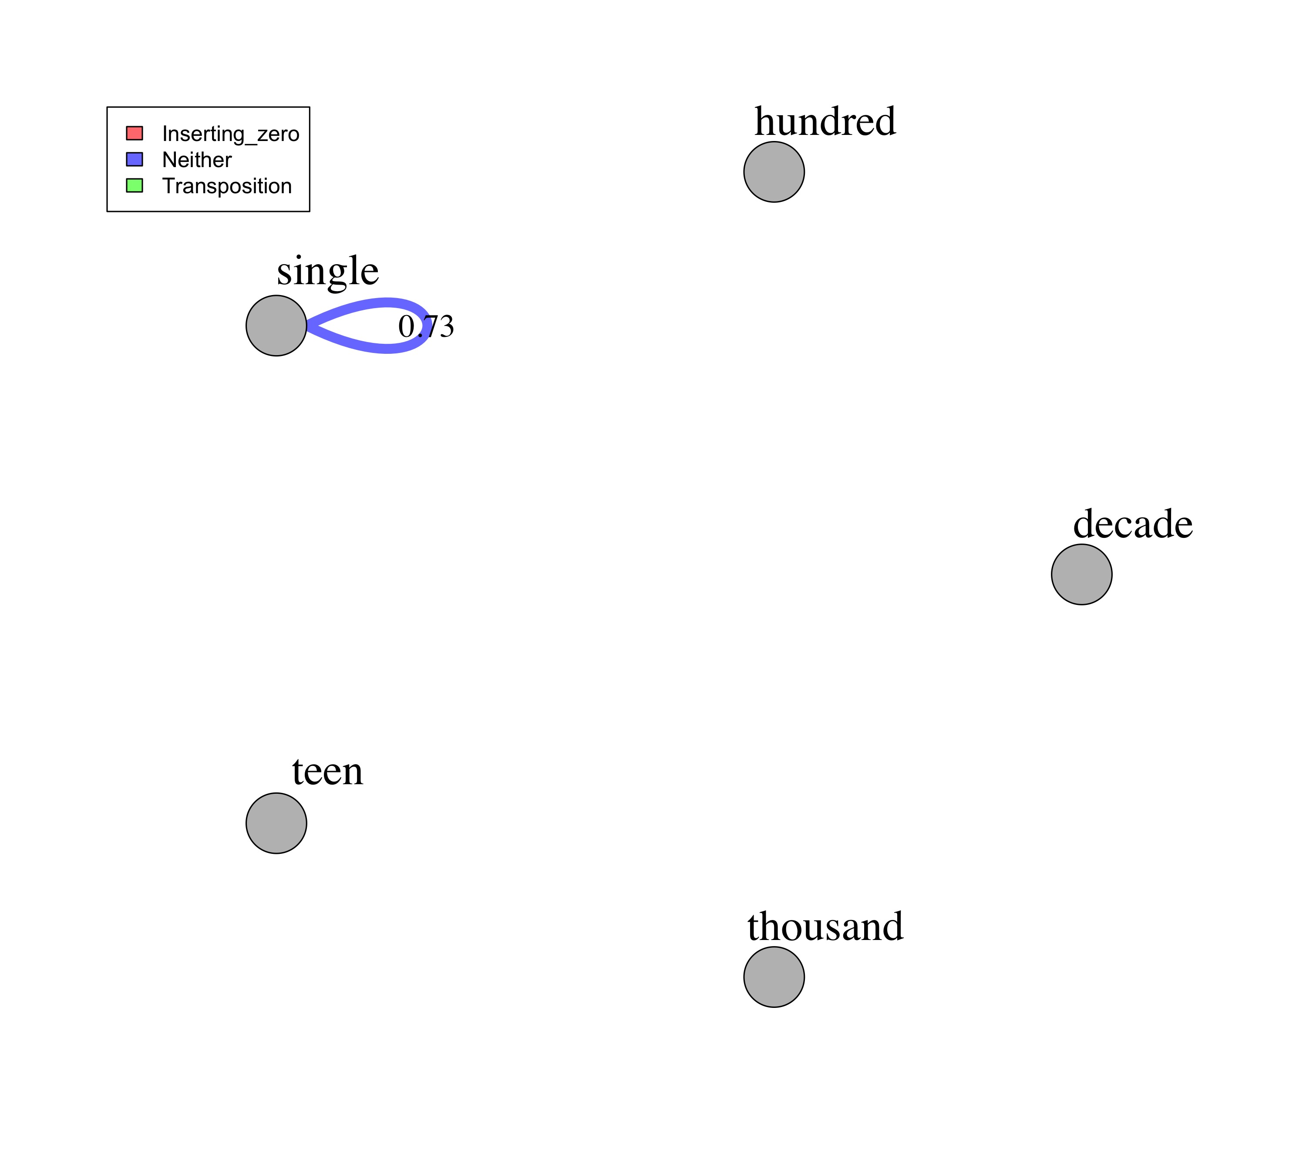

Slide 2
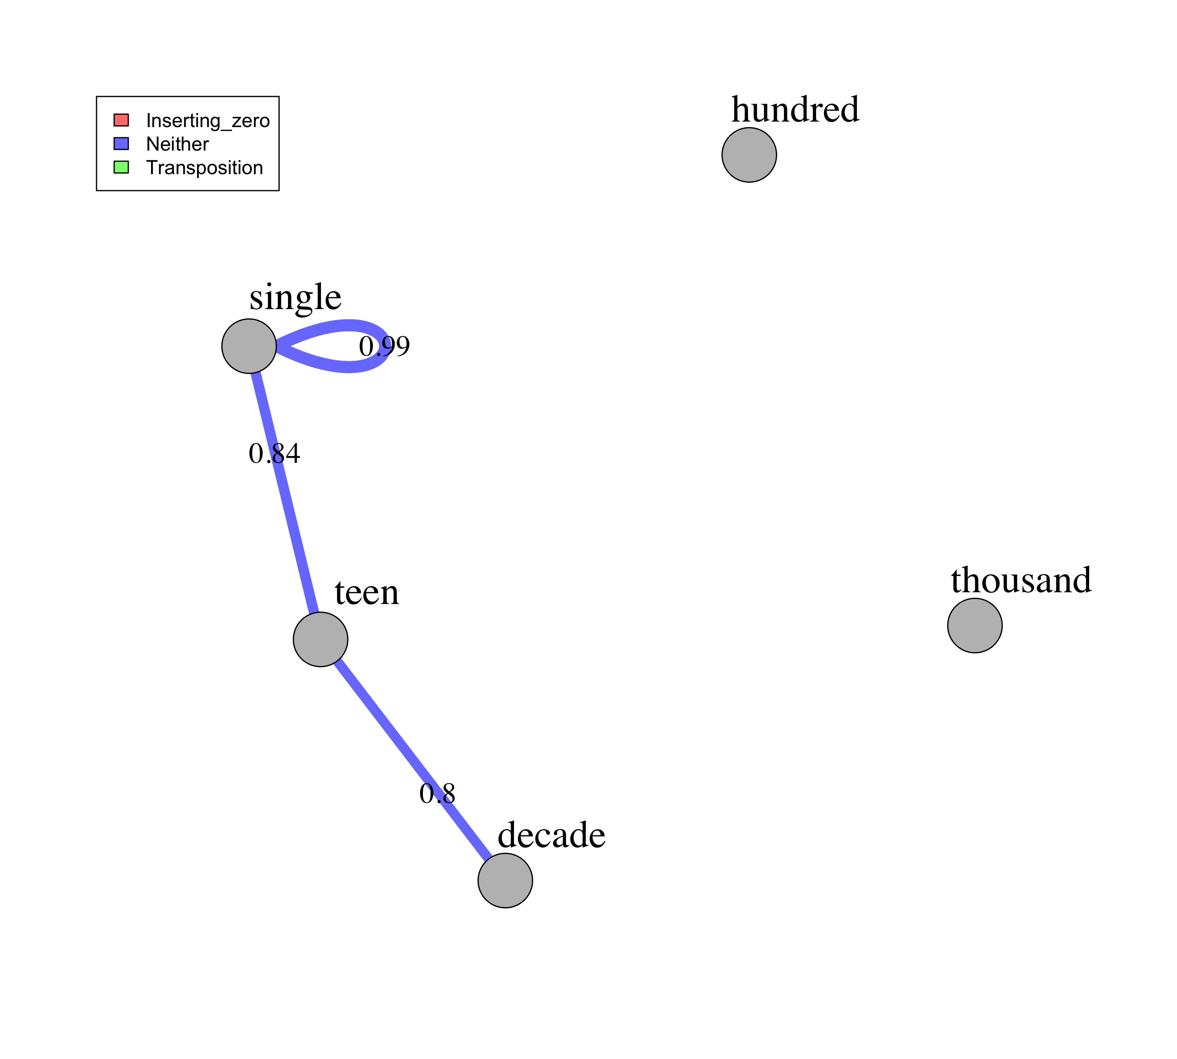

Slide 3
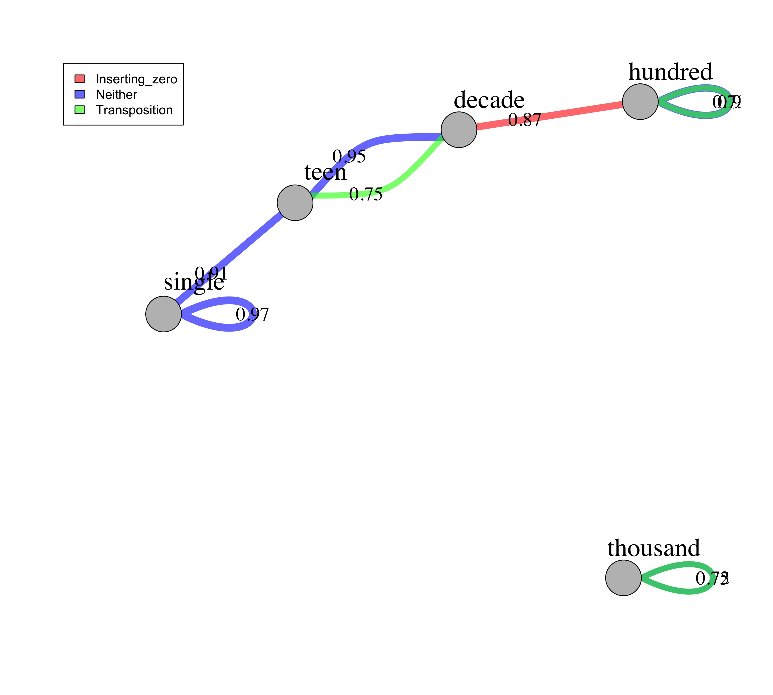
0.90
Hundred
Decade
0.95
0.87
Teen
0.73
0.75
0.91
Single
0.97
0.72
Thousand
0.75

